Slide 1
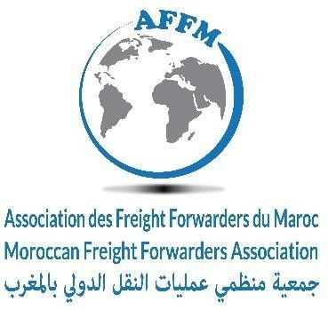
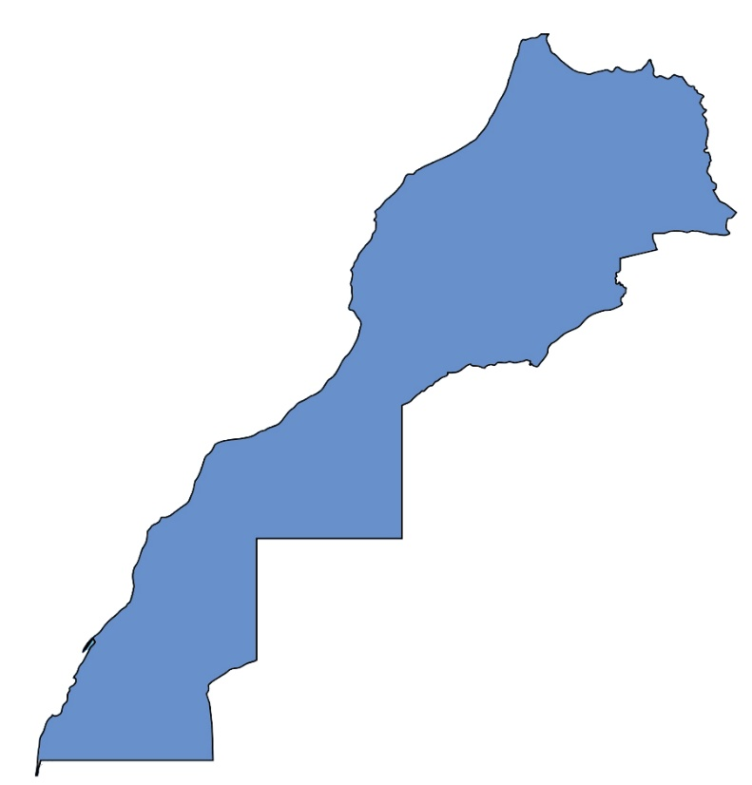
      Morocco Overview
GDP | 180 Billion MAD (2025) US$ 116 Billion
GDP per capita | 47.000 MAD/ inhabitant (2025) US$ 4700-4800
Average growth | 4.2% (over the last 5 years)
GDP Distribution (2025) | Service | 54/56 %
 | Industry | 27/29 %
 | Agriculture ,Foresty & Fishing | 11/14 %
Inflation Rate | 0.8 % (2025) About
Capital | Rabat
Institutional System | Democratic and social Constitutional Monarchy
Area | 710 850 km²
N° of inhabitants | 36.8 million
Time Zone | GMT (GMT+1 )A part Ramadan
Languages | Arabic and Amazigh (official) French, Spanish, English
3

Slide 2
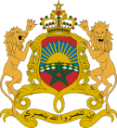
Political stability, strong institutions
A continuing drive for openness and democratisation
A monarchy established in the year 788 (12 centuries ago)
In July 2011, a referendum established a new Constitution, an additional step forward in many fields :
  Human rights
  Legality of the State and its institutions
  Individual and collective liberty
  Improved moral standards in public life
  Plurality of the Moroccan identity
Morocco, in top 3 most stable country in North Africa
Morocco, most pacifist country in North Africa in
Morocco, most democratic country in Arab region
4

Slide 3
Healthy national economy
Average
2024
2025
GDP Growth
3.6%
3.8%
4.4%
2000-2025
Inflation
2%
1.0-1.7%
0.8%
2000-2025
FDI Growth/GDP
1.5%
1%
2.9%
2000-2025
Unemployment rate
10 %
13 %
13%
3
5

Slide 4
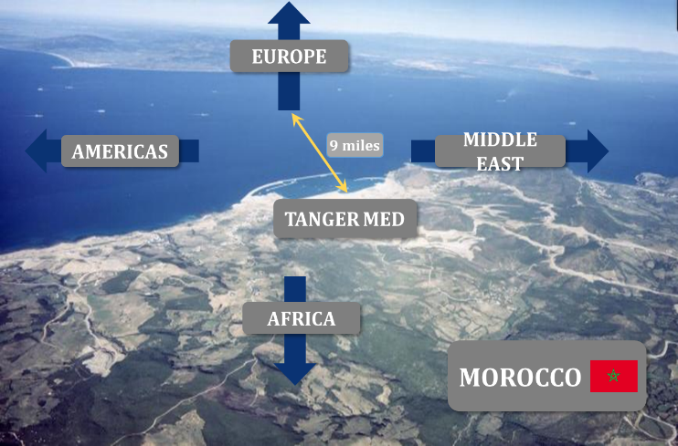
      Unique geographical & geo-political position
      Morocco is a hub for Africa
  Already established maritime hub : Tangier Med
  Real potential for air cargo hub establishment
  Real progress in developing logistic sector
7h
5h
10d
3h
3.5h
NEW YORK
2d
3d
PARIS
3h
FRANKFURT
1h
3h
1d
2d
MADRID
ROME
22h
4h
30d
5d
4h
BEIJING
ACCRA
4d
3h
CAIRO
4d
Flight duration
DAKAR
Sea/land route
10h
25d
SAO PAULO
19

Slide 5

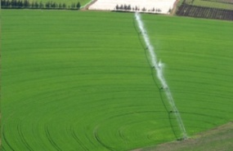
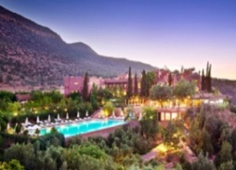
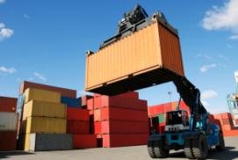
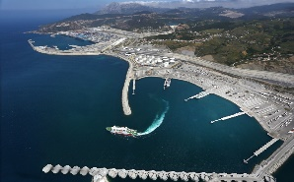
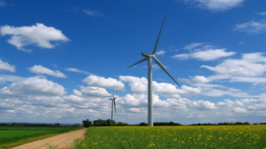
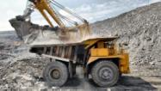
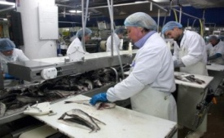
      Long term vision and sustainable growth oriented strategies
      Industry, tourism, agriculture, renewable energy – renewable energy, …
INDUSTRY: Performant Ecosystem Strategy 2020
AGRICULTURE: GREEN MOROCCO PLAN 2020
Launched in 2014
  Industrial GDP represent 25% of global GDP by 2025
  Creation of 500 000 jobs
  Creation of Industrial Development Fund: $2.5 Bn
  Allocation of 1 000 hectars of land for rent
Launched in 2008
  To modernise the agricultural sector
  US$10 billion in additional GDP from agriculture
  US$15 billion in public and private investments
TOURISM: 2020 VISION
LOGISTICS PLAN 2030
Launched in 2010
Launched in 2010
  20 million tourists in 2025
  200 000 new beds
  Tourism GDP: from US$6 billion in 2010 to US$17 billion in 2020
  To improve the country’s logistical competitiveness
  To reduce logistical costs from 20% to 15% of GDP
  An integrated national network of 50 multi-flow logistical zones
ENERGY: MOROCCAN SOLAR PLAN 2020
PORT STRATEGY 2030
Launched in 2009 (Solar) and in 2010 (Wind)
  US$ 7 billion of investment
  Increasing port capacity from 140 to 370 million tonnes
  New large-scale projects: Nador West Med, Kenitra Atlantique, Dakhla Atlantique, Safi new port, Jorf Lasfar new energy port…..
  Renewable energy > 40% of national production by 2020
  Capacity: 2 000 MW of solar power + 2 000 MW of wind power
MINING SECTOR 2025
IT: MAROC NUMERIC
  Turnover X3 ➔ US$ 1.5 billion
  Investment X10 ➔ US$ 0.4 billion
  Jobs X2 ➔30 000
Launched in 2009
  Generalized access to broadband
  Encourage IT use by SMEs
  Development of government e-services
6

Slide 6
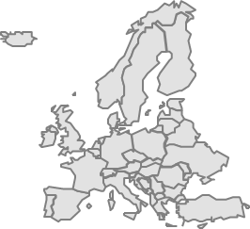
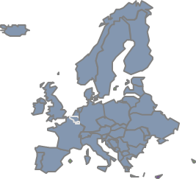
      FTA access to a huge market
      >1 billion consumers and 60% of global GDP
Agreement under negotiations
with Canada
Association Agreement with European Union (1996)
Agreement with Turkey (2003)
Agreement with United States of America (2005)
Agadir Agreement (2004)
United Arab Emirates Agreement (2003)
Arab League Agreement (1998)
Agreement under negotiations with the Economic Community of West African States (ECOWAS & CEMAC)
Since 2008, Morocco has an Advanced Status with the EU
7

Slide 7
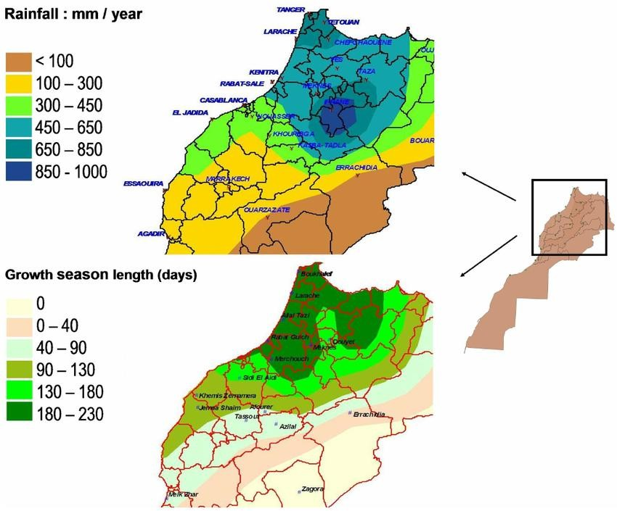
Morocco: A Competitive Agribusiness Platform Strong agricultural base
One of Africa’s leading agri-exporters
Diverse production: citrus, vegetables, olive oil, seafood
Modern irrigation and farming systemsFood-processing opportunities
Fruit and vegetable processing
Seafood processing and canning
Frozen and prepared foods
Packaging and cold-chain logisticsExport platform advantages
Fast access to European markets
Growing West African demand
Competitive production costs
Industrial free zones near portsFertilizer and agricultural inputs
Home to OCP Group, global leader in phosphates and fertilizers
Opportunity for partnerships in agricultural productivity
20

Slide 8
      Very good ranking for "Doing Business“
2020 : 53nd in doing business (World Bank)
2024- 2025 : 2nd in Africa
Investor Protection
51 Double Tax Avoidance Agreements
62 Investment Protection Agreements
Member of OECD Investment Committee
Member of International Centre for Settlement of Investment Disputes (ICSID)
Member of MIGA (Multilateral Investment Guarantee Agency)
Legal Reforms
The creation of the Business Environment National Committee (CNEA) to facilitate procedures and access to information, and to carry out legal reforms
The modernisation of business law
The strengthening of intellectual property protection
A new law on arbitration and mediation
New banking regulations
Administrative simplification
An Incentive Tax System
Reduction of tax burden
Creation of funds specifically for investment promotion
International Instruments
Morocco adhered to the OECD Declaration on Propriety, Integrity and Transparency in the Conduct of International Business and Finance and to the OECD Declaration on Green Growth
8

Slide 9




      Easiness in Doing Business
MOROCCO
CHINA
TURKEY
TUNISIA
STARTING
A BUSINESS
9 days
9 days
7 days
11 days
5 steps
4 steps
7 steps
11 steps
Cost: 8%
Cost: 1%
Cost: 16%
Cost: 3%
% of income per capita
PAYING
TAXES
232 hours/year
261 hours/year
226 hours/year
144 hours/year
6 steps
7 steps
11 steps
8 steps
Rate: 49%
Rate: 64%
Rate: 40%
Rate: 62%
% of profit
EXPORT
61 Hours
21 Hours
30 Hours
55 Hours
4 documents
3 documents
5 documents
4 documents
156 US$
256 US$
338 US$
475 US$
IMPORT
6 days
2 days
3 days
12 days
3 documents
3 documents
6 documents
5 documents
350 US$
390 US$
290 US$
740 US$
9

Slide 10
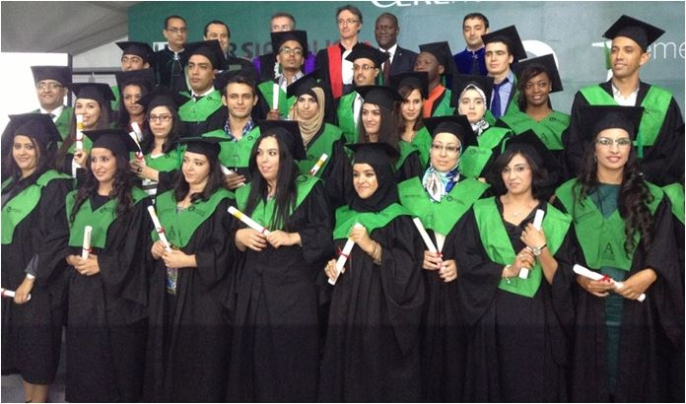
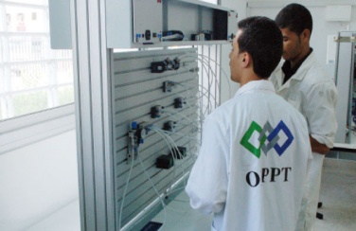
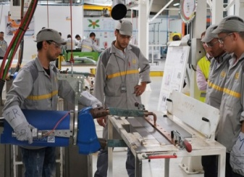
      Strong Human Resources advantage
      young and well educated workforce, government supporting training
A young and well educated workforce
Government support for training
  64% of Moroccans are aged under 34 years
  1.300 000 university students 2024-2025
  11.000 engineering graduates per year.
  ~12-15 millions of French speakers
  ~2-3 millions of Spanish speakers
  English: 5-7 millions of English speakers
  Strong cultural and linguistic affinity with Europe
Dedicated entity for professional training (OFPPT)
  A network of 337 schools with ~400 000 trainees
  Training in 6 industries:
    Industrial, Tertiary, Construction, ICT, Tourism, Transport & Logistics
Government partnering with investors for training
  Creation of an Automotive Training Institute (IFMIA) for the workers of the Renault plant
  Morocco financed 100% of the training facility
OFPPT center
IFMIA Tangier
11

Slide 11

An Attractive Incentive Package : conventional regime
Strategically and sustainably supporting foreign investments
Investment Promotion
Funds
(IPFs)
Hassan II Fund
Offshoring Sector Incentives
Eligibility Conditions:
  Investment ≥ 100 M DH (10 M US$)
  Jobs created ≥ 250
  Transfert of technoloy
  Implementation in a priority area
  Protection of environment
Land Assistance: A contribution up to 20% of acquisition costs
External Infrastructures: assistance of up to 5% of total amount of investment programme
Training: A contribution of up to 20% of training costs.
Eligibility Conditions:
  Total investment ≥ 1O M DH (1M US$)
  Investment in goods and equipment ≥ 5 M DH
  Sectors: Automobile, aeronautics, nanotechnology, microelectronics, and biotechnology.
Contributions are limited to a maximum of 15% of the total investment and US$ 3.7 million as the following:
  Land Assistance: 30% of costs of land acquisition and development.
  Equipment: 15% of costs of new equipment (excluding taxes and import duties).
Corporate tax Full exoneration for first 5 years and 17,5% starting from the 6th year
  Income Tax : 20% cap in Nearshoring Business Parks
Training Subsidies up to US$7,800 (over 3 years)
or
12

Slide 12
Strategically and sustainably supporting foreign investments
      An Attractive Incentive Package
General Tax
Code
Free zone regime
(industrial acceleration zones)
Casablanca Finance
City
    Eligibility Conditions
      Investment ≥ 100 M DH ((10 M US$)
    VAT exemption for the importation of equipment goods, materials, and tools for the 36 months following the start of the activity.
    This exemption is also granted to parts, spare parts and accessories imported at the same time as the above equipment
    Exemption from import of equipment goods, materials, and tools for the 36 months after the signing of the Investment Agreement
    Eligibility Conditions
      70% of sales to be achieved abroad
Tax incentives (2025)Companies operating in Moroccan free zones typically benefit :
Corporate tax (IS)
• 0% for the first 5 years
•15% after that VAT
•Exemption on exports
•VAT suspension for certain transactions inside the zone Customs
• Duty-free import of equipments, raw materials and components for export production. Companies must generally be located inside an Industrial Acceleration Zone be export-oriented Operate in industrial, logistics, or service-export activities
    Eligibility Conditions
      Activities with non-resident businesses
      Compliance with financial legislations and regulations, foreign trade and foreign exchange
    For service companies CFC status:
    Total exemption from corporate tax for companies during the first 5 years of operation and 8.75% thereafter.
    For regional and international office:
    Taxed at a reduced rate of 10% (corporate tax)
    Specific taxation rate of 20% for wage income (income tax)
    Exemption acts of incorporation and capital increase
13

Slide 13
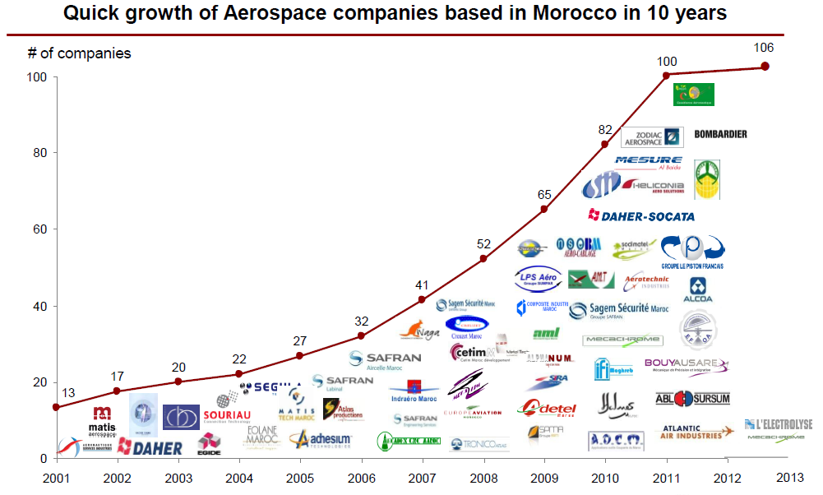
      Morocco, already a land of huge achievements
  And several aerospace leaders settled
Key Figures 2025
By 2025, Morocco’s free zones / Industrial Acceleration Zones have achieved roughly:
• 300,000+ jobs created
• 1,400–1,500 companies installed
• More than 60% of Morocco’s industrial exports generated in these zones
• Dozens of industrial parks across the country.They are now the core platform for export-oriented industry in Morocco.
15

Slide 14
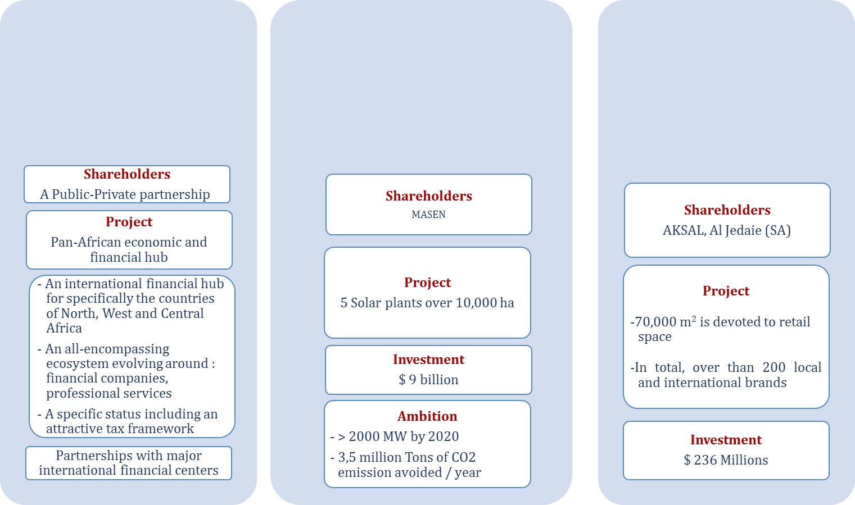
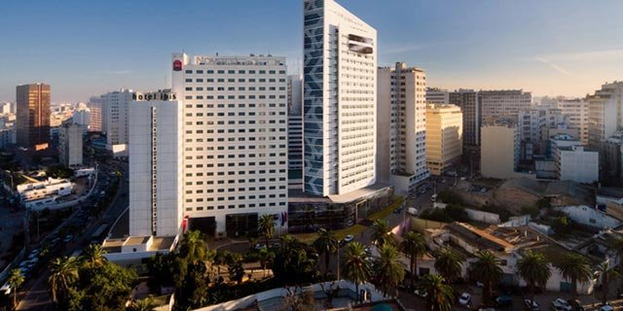
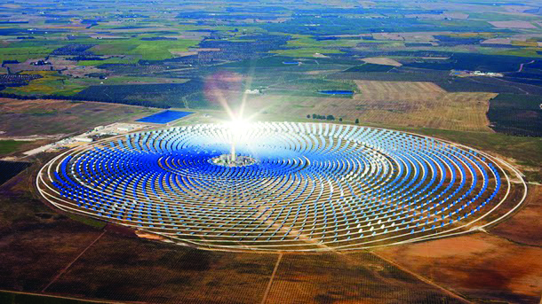
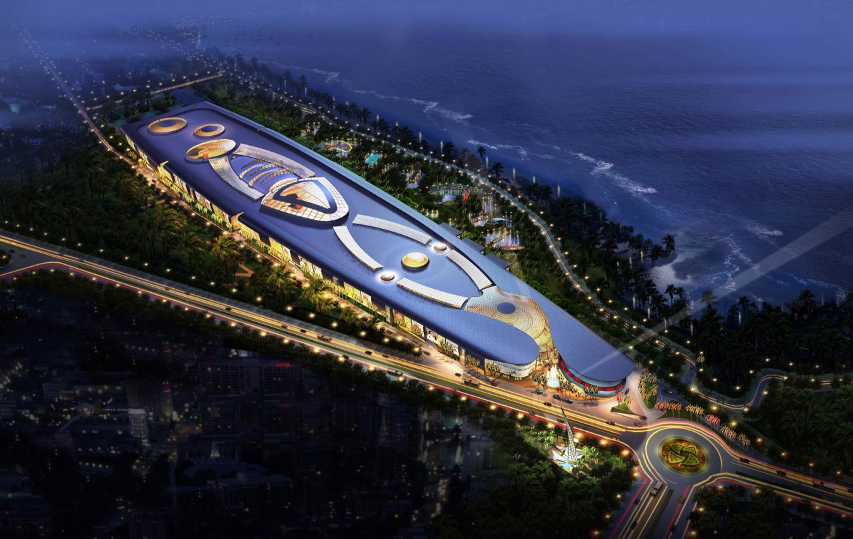
      Morocco, already a land of huge achievements
Financial hub
Casa Finance city
Solar energy
Noor, Ouarzazate
largest solar energy plan Worldwide
Retail
Morocco Mall, Casablanca
largest mall in Africa
  …and many other large-scale projects…
16

Slide 15
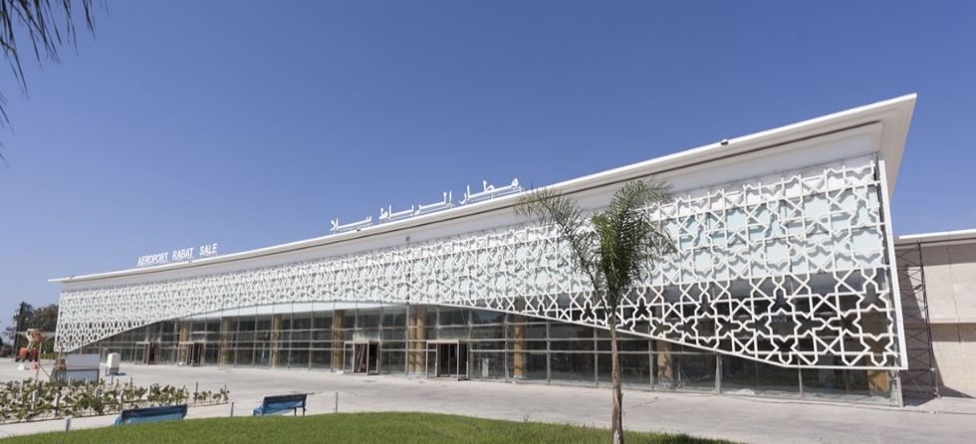
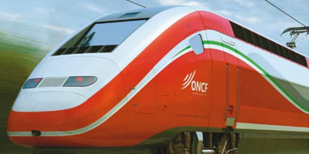

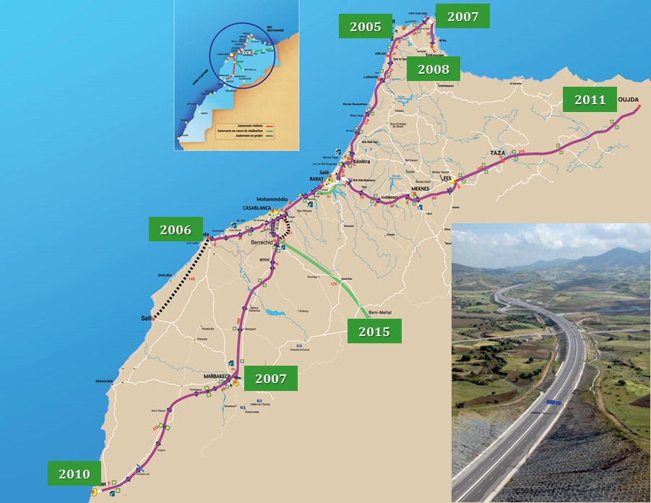
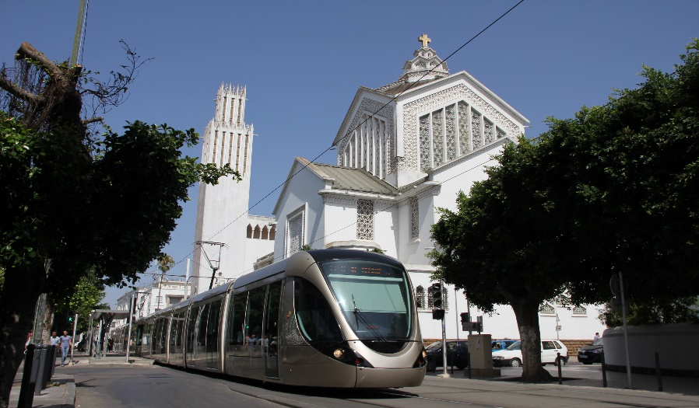
      Morocco, already a land of huge achievements
Modern Transport Infrastructure
Airports
  15 international airports
  Casablanca is #1 Europe-Africa hub
Railway Network : 2110 km
  First high-speed train in Africa: Tangier-Casablanca- 200 kms under construction
  US$ 2 billion
  Tangier Med Port:
  World class infrastructure with a strategic position
  Integrated offer of industrial, logistics and trade areas close to the port
  Ideal port/hub for Europe and Western Africa
  Current achived : 10 millions TEUs
  world’s top 15-20 transshipment ports
Highways: 1800 kms in service and 3000 km in 2030
Already connecting all large and medium cities in Morocco
  Roads: 60 thousands kms
Tramways
  Rabat and Casablanca
  Investment of US$ 1 billion
17

Slide 16
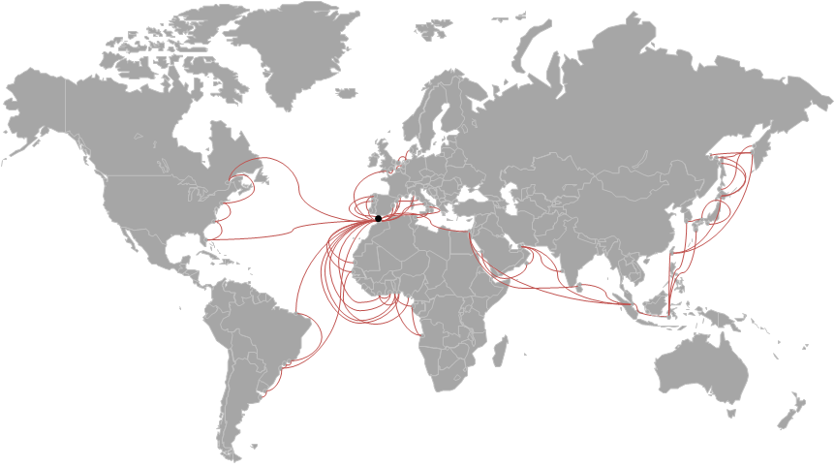
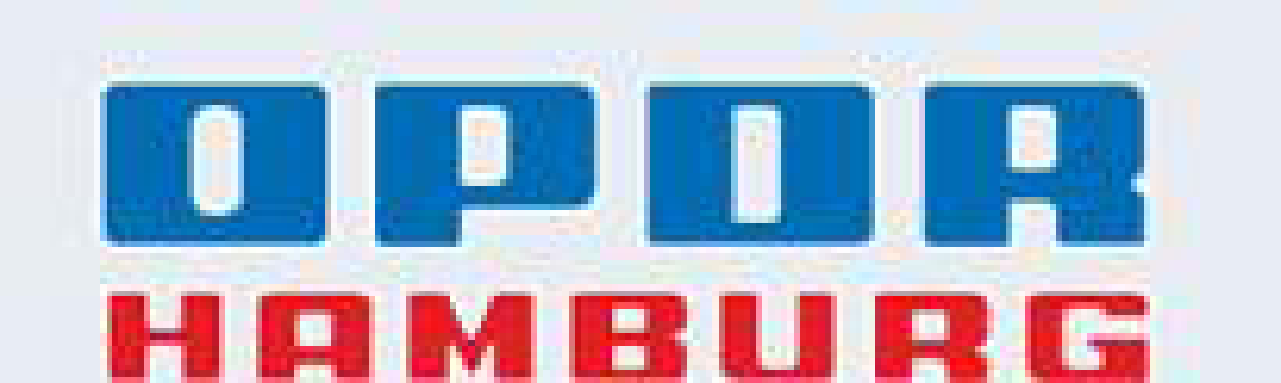






World Class maritime connectivity
Tanger Med Port - Logistics Hub of international stature
Connections to 180 ports in 70 countries
Around 40 African ports served regularly
20

Slide 17
LOGISTICS ZONES PROGRAM
20

